Slide 1
Database Maintenance
10 Mar, 2025

Slide 2
Course : Amazon Redshift
Lecture On : Database Maintenance
Instructor : Nitin

Slide 3
In Last Class, we covered….
01
Factors that impact query performance
Table maintenance and materialized views
Query analysis
Workload management
Tuning guidance
Amazon Redshift monitoring
02
03
04
05
06

Slide 4
Poll 1(Answer)
Which of these are categorical variables?
Temperature of an engine
Make of car
Mileage of a car
Rating given by a customer for an Uber ride
Practice in teams of 4 students
Industry expert mentoring to learn better
Get personalised feedback for improvements

Slide 5
Today’s Agenda
01
DML Commands
02
Analysing and Vacuuming Tables
03
Automating CTAS Table Analysis
04
Create UDFs

Slide 6
Introduction to Database Maintenance
What is Database Maintenance?
Regular tasks performed to ensure a database is running smoothly.
Includes tasks such as updating tables, optimizing queries, and cleaning up data.
Aims to improve performance, reduce storage overhead, and maintain data integrity.

Slide 7
Introduction to Database Maintenance
Why is Database Maintenance Important?
Prevents performance degradation.
Helps to prevent data corruption and inconsistency.
Optimizes resource utilization.
Ensures smooth operation and availability of the database.
Key Aspects of Database Maintenance:
Data Management (e.g., updates, inserts, and deletions).
Performance Tuning (e.g., indexing, vacuuming).
Backup and Restore.
Security (e.g., user permissions, data encryption).

Slide 8
Updating Tables with DML Commands
What are DML Commands?
DML (Data Manipulation Language) refers to the SQL commands that are used to manipulate the data in tables.
Includes: INSERT, UPDATE, and DELETE commands.

Slide 9
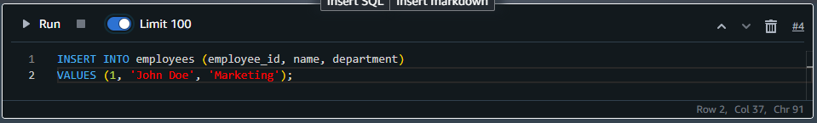
Updating Tables with DML Commands
INSERT Command:
Adds new rows of data into a table.
Example:

Slide 10
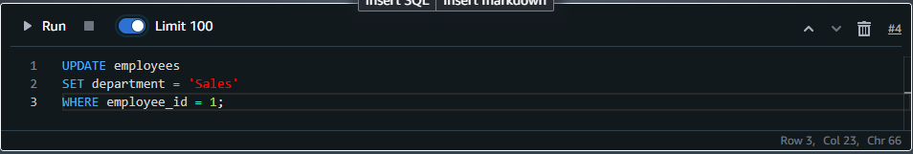
Updating Tables with DML Commands
UPDATE Command:
Modifies existing records in a table.
Example:

Slide 11
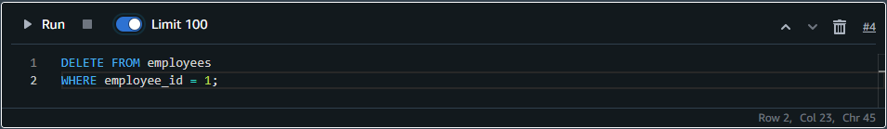
Updating Tables with DML Commands
DELETE Command:
Removes records from a table.
Example:

Slide 12
Updating Tables with DML Commands
Best Practices for DML:
Use transactions to ensure data integrity.
Use WHERE clauses for targeted updates and deletions to avoid unintentional data loss.
Limit the use of DELETE on large tables to prevent performance issues.

Slide 13
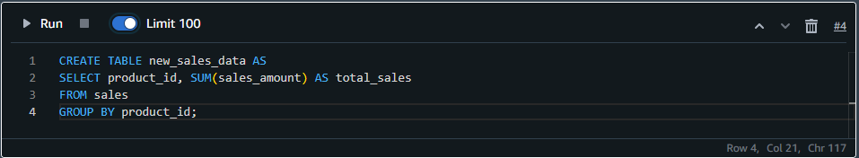
Automating CTAS Table Analysis
What is CTAS (Create Table As Select)?
CTAS is used to create a new table by copying the result of a SELECT query.
It can be used for data transformations, aggregations, or backups.

Slide 14
Automating CTAS Table Analysis
Why Automate CTAS?
Efficiency: Helps with efficient analysis by keeping tables up-to-date without manual intervention.
Batch Processing: Can be scheduled at off-peak hours to reduce the impact on live workloads.
Data Aggregation: Useful for creating summary or analytical tables.
Example of Automation:
Set up a scheduled job (e.g., using AWS Glue, Airflow, or cron jobs) to run the CTAS script regularly.

Slide 15
User-Defined Functions
A User-Defined Function (UDF) is a function created by the user to extend the capabilities of the database.
UDFs are written in SQL or other programming languages (e.g., Python, JavaScript) depending on the database.
Why Use UDFs?
Custom Logic: Allows users to implement complex logic that is not natively supported by SQL.
Reusability: UDFs can be reused across multiple queries or applications.
Optimization: Can help optimize certain repetitive or complex calculations.

Slide 16
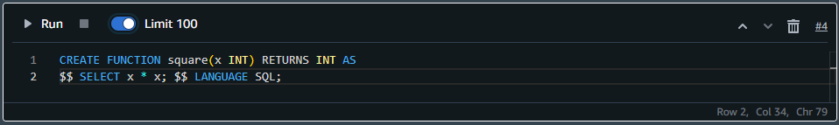
UDF Creation
Define the Function:
Choose the language (e.g., SQL, Python, etc.) and define the function.
Example (SQL-based UDF to calculate the square of a number):

Slide 17
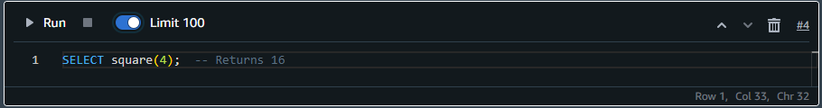
UDF Creation
Deploy the Function:
Deploy the function to the database, making it available for future queries.
Use the Function:
Once the UDF is created, it can be used in SQL queries just like any built-in function.
Example:

Slide 18
Maintain and Optimize UDFs:
Monitor the performance of UDFs to ensure they are not causing performance bottlenecks.
Refactor or optimize the UDF logic when necessary.
Best Practices for UDFs:
Keep UDFs simple and focused on a single task.
Avoid using UDFs for complex operations that can be done directly in SQL for performance reasons.

Slide 19
Knowledge Check
What happens if a column in the SELECT query used in CREATE TABLE AS SELECT (CTAS) has an alias?
A) The alias will be ignored in the new table.
B) The alias will become the name of the new column in the created table.
C) The column with the alias will not be included in the new table.
D) An error will occur due to the alias.
19

Slide 20
Knowledge Check
What happens if a column in the SELECT query used in CREATE TABLE AS SELECT (CTAS) has an alias?
A) The alias will be ignored in the new table.
B) The alias will become the name of the new column in the created table.
C) The column with the alias will not be included in the new table.
D) An error will occur due to the alias.
20

Slide 21
Knowledge Check
When using CREATE TABLE AS SELECT (CTAS) in a database, what must be ensured to avoid issues with the SELECT query?
A) The SELECT query must be highly optimized for performance.
B) The SELECT query should always return an empty result set.
C) The SELECT query must always use JOIN operations.
D) The SELECT query must include at least one GROUP BY clause.
21

Slide 22
Knowledge Check
When using CREATE TABLE AS SELECT (CTAS) in a database, what must be ensured to avoid issues with the SELECT query?
A) The SELECT query must be highly optimized for performance.
B) The SELECT query should always return an empty result set.
C) The SELECT query must always use JOIN operations.
D) The SELECT query must include at least one GROUP BY clause.
22

Slide 23
Knowledge Check
Which of the following is true about the lifecycle of a User-Defined Function (UDF)?
Once created, a UDF cannot be dropped from the database.
UDFs are permanent and do not need to be redefined.
UDFs can be dropped or modified at any time by the database admin.
UDFs are automatically created each time the database restarts.
23

Slide 24
Knowledge Check
Which of the following is true about the lifecycle of a User-Defined Function (UDF)?
Once created, a UDF cannot be dropped from the database.
UDFs are permanent and do not need to be redefined.
UDFs can be dropped or modified at any time by the database admin.
UDFs are automatically created each time the database restarts.
24

Slide 25
Knowledge Check
Which of the following database objects can be used within a User-Defined Function (UDF)?
Views
Temporary tables
Triggers
Indexes
25

Slide 26
Knowledge Check
Which of the following database objects can be used within a User-Defined Function (UDF)?
Views
Temporary tables
Triggers
Indexes
26

Slide 27
KEY TAKEAWAY
UDFs allow users to extend SQL functionality by creating custom functions for complex calculations or transformations, improving query flexibility. However, they can impact performance if not optimized properly.
01
CTAS creates a new table based on the result of a SELECT query, simplifying data transformation and aggregation, but does not carry over constraints or indexes.
02
27

Slide 28
NEXT CLASS
01
Overview of analytics
Identifying challenges with analytics
AWS services for challenges with analytics
Introduction to Data Lakes
Introduction to Data Warehousing
AWS Services for Modern Data Architecture
02
03
04
05
06
28

